Slide 1
Battle of Neighborhoods New York City and Toronto
Saubhik Bagchi
July 21, 2019

Slide 2
Introduction
In today's world, it's very common for people to relocate from one city to other across the world for education, business, jobs and other personal reasons. Someone getting a better job offer from another city may decide to relocate however she/he would like to find out a neighborhood in the new city where similar amenities are available so that she/he can feel comfortable after relocating to the new place.
If someone likes the comfort of quality Italian food in her neighborhood restaurants, she would probably look for a neighborhood in the new city where there are plenty of good Italian restaurants around her. Same goes for other amenities like coffee shops, school, gym, amusement park, grocery stores, super markets etc.

Slide 3
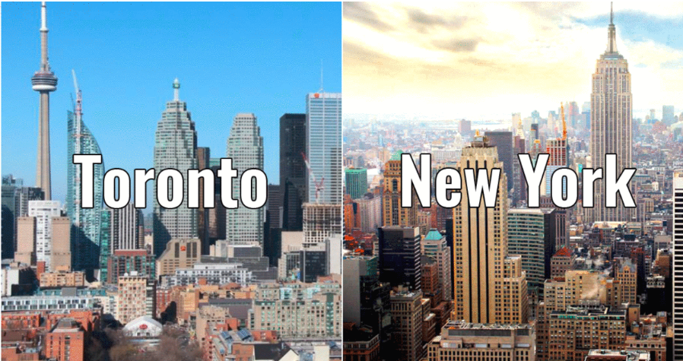
Business Problem
Let me define a business problem for this project. Debbie lives in Bronx, Riverdale, New York and she loves her neighborhood. She got a great job offer from Toronto, and she decided to relocate to Toronto in 2 weeks’ time to take up the new opportunity.
Debbie wants to find out a neighborhood in Toronto where she would get similar amenities available around her that she gets in Bronx. Our problem statement is to explore the neighborhoods of Toronto and see which of them closely matches with Bronx and provides similar amenities. Based on our analysis we can recommend Debbie which Toronto neighborhoods should be the top choice for her!

Slide 4
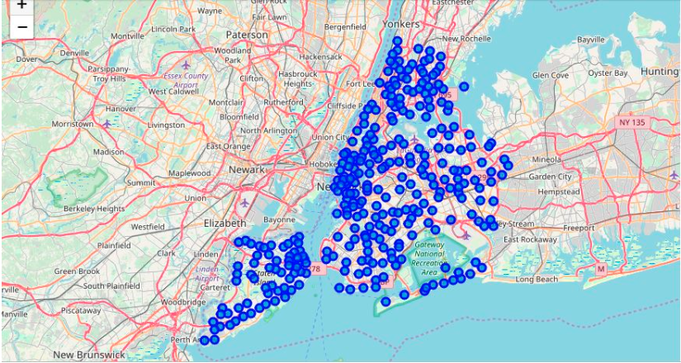
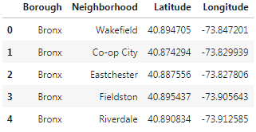
New York City Data
New York neighborhoods are shown on the map, we will use Foursquare API to get venue information for the neighborhoods

Slide 5
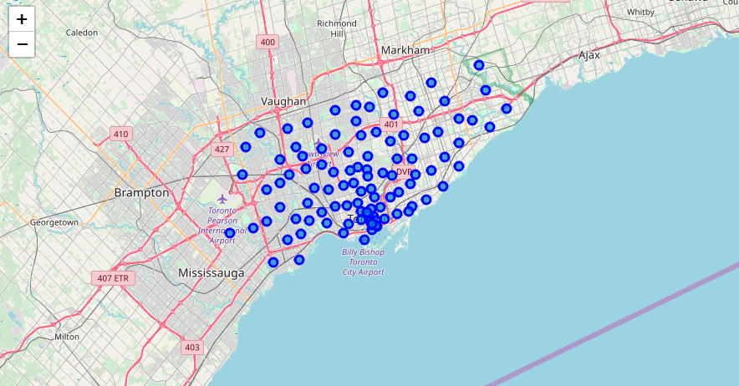
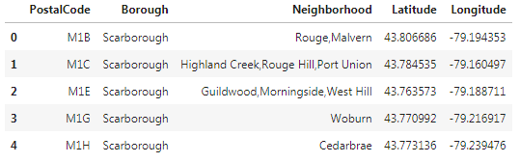
Toronto Data
Toronto neighborhoods are shown on the map, we will use Foursquare API to get venue information for the neighborhoods

Slide 6
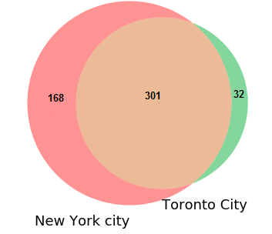
Exploratory Data Analysis
New York City and Toronto has different number of venues. New York has 469 and Toronto has 333 venue categories. There are some common venue categories in both cities. We’ll find the common venue categories and keep only these common categories to find similar neighborhoods.
Common venue categories : 301
Other categories in New York City are: 168
Other categories in Toronto are : 32

Slide 7
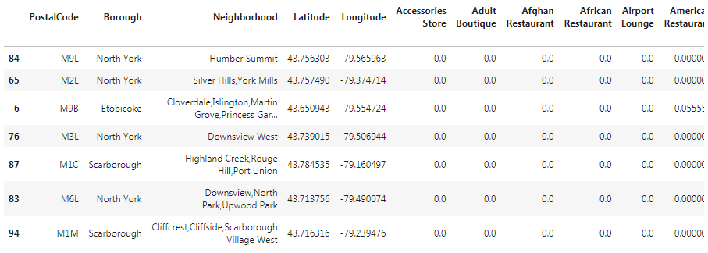
Find most similar location using Cosine Similarity
We get all common venue categories of Bronx and calculate matrix product with Toronto City common venue data. This will give quantitative measure of similarity of each borough of Toronto city to Bronx. We can sort in descending order and select top 7 similar boroughs

Slide 8
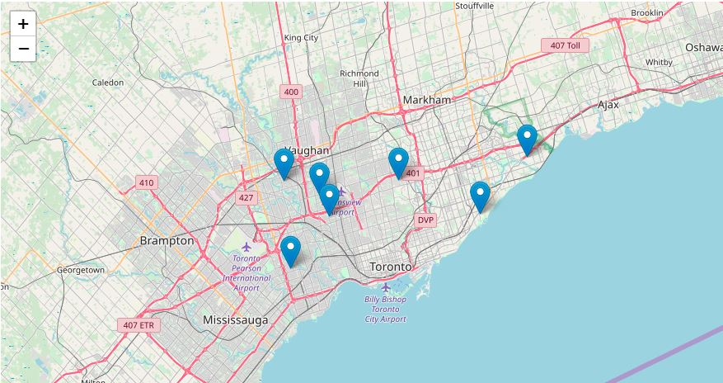
See the top 7 locations on map
See the entire report of this project at this link https://github.com/saubhik-bagchi/data-science-capstone/blob/master/Report-Battle%20of%20Neighborhoods.pdf

Slide 9
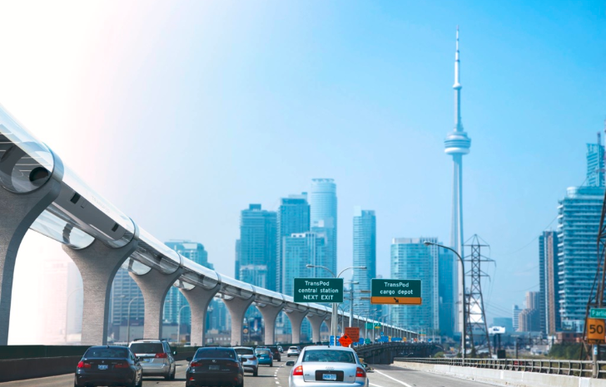
Conclusion
We started this project with a problem statement for Debbie. She lives in Bronx, Riverdale, New York and she loves her neighborhood. She got a great job offer from Toronto, and she decided to relocate to Toronto in 2 weeks’ time to take up the new opportunity.
Debbie wants to find out a neighborhood in Toronto where she would get similar amenities available around her that she gets in Bronx. We retrieved location information using Foursquare API, used exploratory data analysis and Cosine Similarity algorithm to identify top 7 neighborhood of Toronto which closely resembles Bronx. Now Debbie can get over the battle of neighborhood and can confidently choose a Toronto neighborhood that will be identical to Bronx!

Slide 10
Thank you

